Slide 1
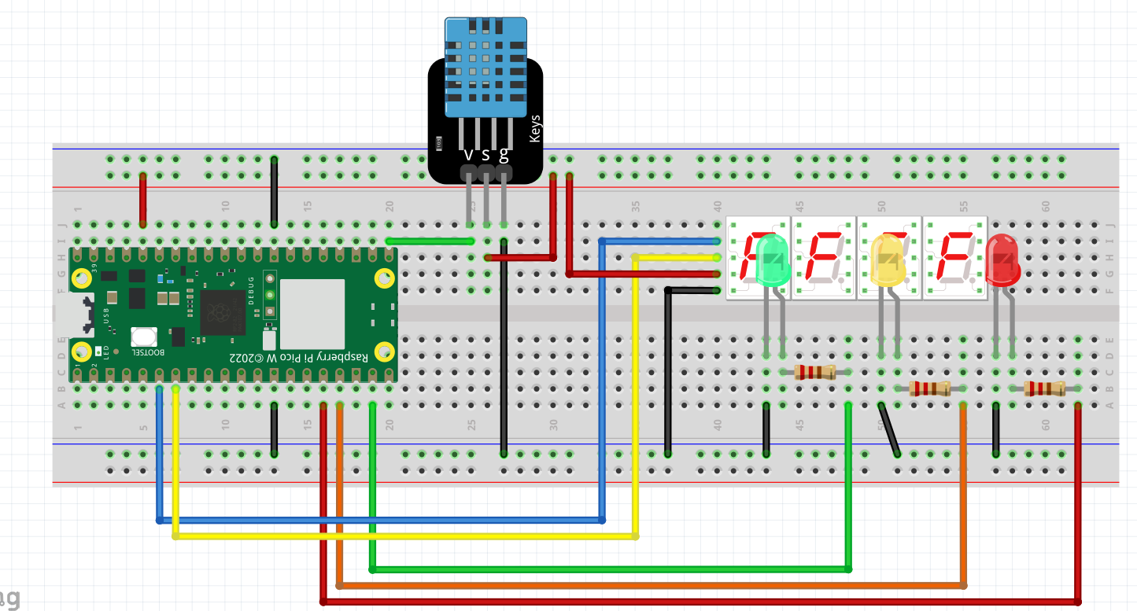

TEMPERATURE MONITORING SYSTEM
S
_

Slide 2
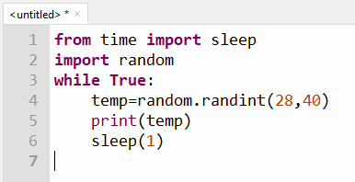
PYTHON – RANDOM INTEGERS AND CONDITIONAL STATEMENTS
THIS PROJECT SIMULATES A TEMPERATURE MONITORING SYSTEM
TO ACCOMPLISH THIS PROJECT, WE WILL NEED TO USE
THE “IF” CONDITIONAL STATEMENTS
The temperature and humidity readings from a dht11 can be said to be random.
It is not predictable. For our demonstration we will use a random number
generator to simulate the temperature reading of the dht11
In python it is random library
import random
This is the random number generator library
Getting the Random number
Generator to give us a random
number from 28 to 40
If you run this program with the plotter
Turned on, you can see the data display
graphically

Slide 3
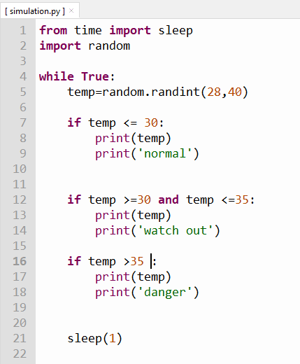
We use a random number generator
To simulate temperature data from
The dht11. We will get integer values ranging from 28 to 40
What actions to take depends on the values given or read
By the dht11
This is the sampling time for the dht11. You can use this to
Determine how much time in between each temperature and
Humidity reading.

Slide 4
This is Ex 4.
Using the knowledge gained so far modify the simulation.py program to achieve the following:
Temp below or equal to 30 Deg C – display green led, turn off the other two
Temp above 30 but below 35 Deg C – display yellow led, turn off the other two
Temp above 35 Deg C – display red led, turn off the other two
Temperature Readings to be displayed on the 7 segment display
Additional Challenge: Add a buzzer on your own and sound buzzer for Temp above 35 Deg C

